Slide 1
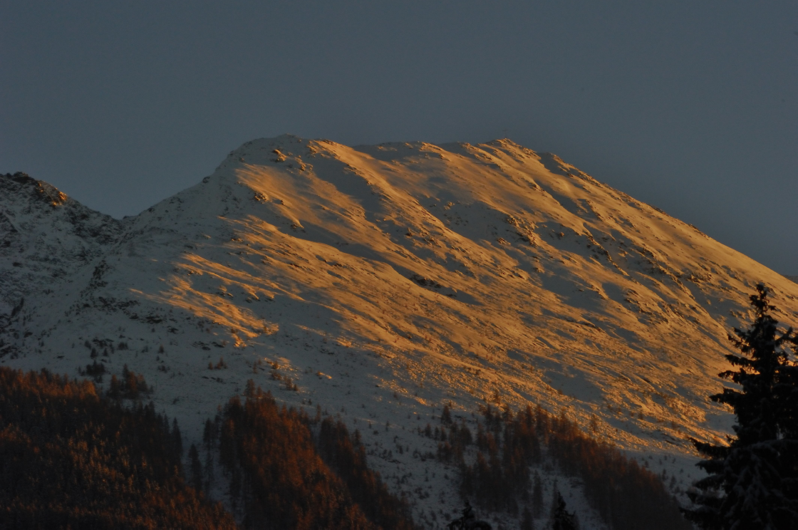
IBTP KOSCHUCH:
PULSE COMPRESSION RADARS FOR MOVING OBJECTS AND PEOPLE CONTROL, NATURAL HAZARDS MONITORING AND MINING SAFETY I
Richard Koschuch, Ph.D.

Slide 2
ABOUT IBTP KOSCHUCH
IBTP Koschuch was founded in 2010 to provide engineering and physical analysis services for private companies and public entities. Its founder, Dr. Richard Koschuch, studied Technical Physics at the TU Graz/Austria and did his PhD at the Austrian Academy of Sciences.
The company is active in the field of physical measurement and has developed patented products and services including radars, X-ray detectors, rock fall sensors, etc.
The company currently provides services for public and private entities in Europe (Austria, France, Italy, Switzerland) and Asia (China, India), offering the possibility to cover all the needs of its clients in terms of natural hazard security (in the face of phenomena such as avalanches, landslides, earthquakes, tsunamis), movement control, location of people and objects on a specific surface.

Slide 3
SERVICES
2. Early and permanent detection of natural hazards
1. Monitoring of people and objects in targeted areas
Localisation and identification of all types of objects (moving or not) in a specified area and under all weather conditions.
For this purpose, we have developed a 10 GHz Pulse Doppler Radar with a over all power consumption of only 20 W, which works on the basis of a unique algorithm adaptable to any company's requirements.
The system can detect multiple targets at different/same distances and speeds at once and triggers any secondary warning system such as traffic lights, sirens, SMS, live viewers etc.
IBTP Koschuch has developed a Radar for avalanches, debris flows, rock falls, and landslides in general that has proven its efficiency since 2011 in Europe and Asia.
An other developed a rockfall detection system consists of a series of energy self-sufficient 3-axis acceleration sensors installed in a protective housing (200x120x58 mm³), with a 6V 2W photovoltaic power supply and a 4000 mAh battery.
The data is sent by radio to a Mobile Gateway and the sensors enable the transfer of information to a server via a gateway.

Slide 4
BENEFITS AND ADVANTAGES OF PULSE RADAR
More than 25 Radars have been installed so far all over the world
All our systems continuously scan the defined area 24/7 and an alarm is issued immediately upon initiation of an event which, in turn, can trigger any secondary warning system.
The speed, reflectivity, distance of the event and all information related to the event are recorded and stored for further analysis as defined by the customer.
Remote Controll of the Radarsystem make it possible to adjust all alarm parameters from the office
Low power consumption makes it possible to run the system with any energy autark power solution.
The Radar works under any weather condition

Slide 5
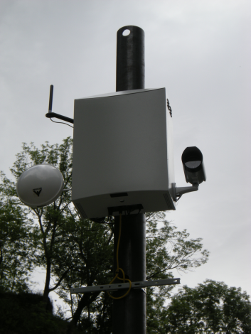
SPECIFICATION OF THE PULSE RADAR
Parameter | Quantity | Tolerance | Unit
Mode | Pulse/PCM
Frequency | 10,0-10,5 |  | GHz
Power C. | 40 | < | W
Range | 30-6000 |  | m
Targetsize | 1 | min > at 2km | m²
 | 0,25 | min > at 1km | m²
Velocity | 0,2-100 | min/max | m/s
RG | 128 | max
RG-length | 15-250 | min/max | m

Slide 6
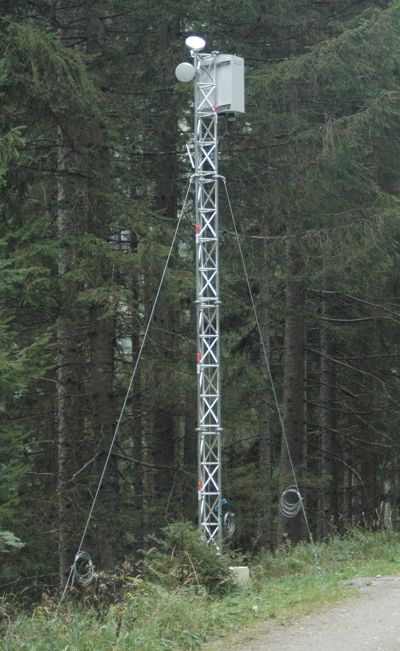
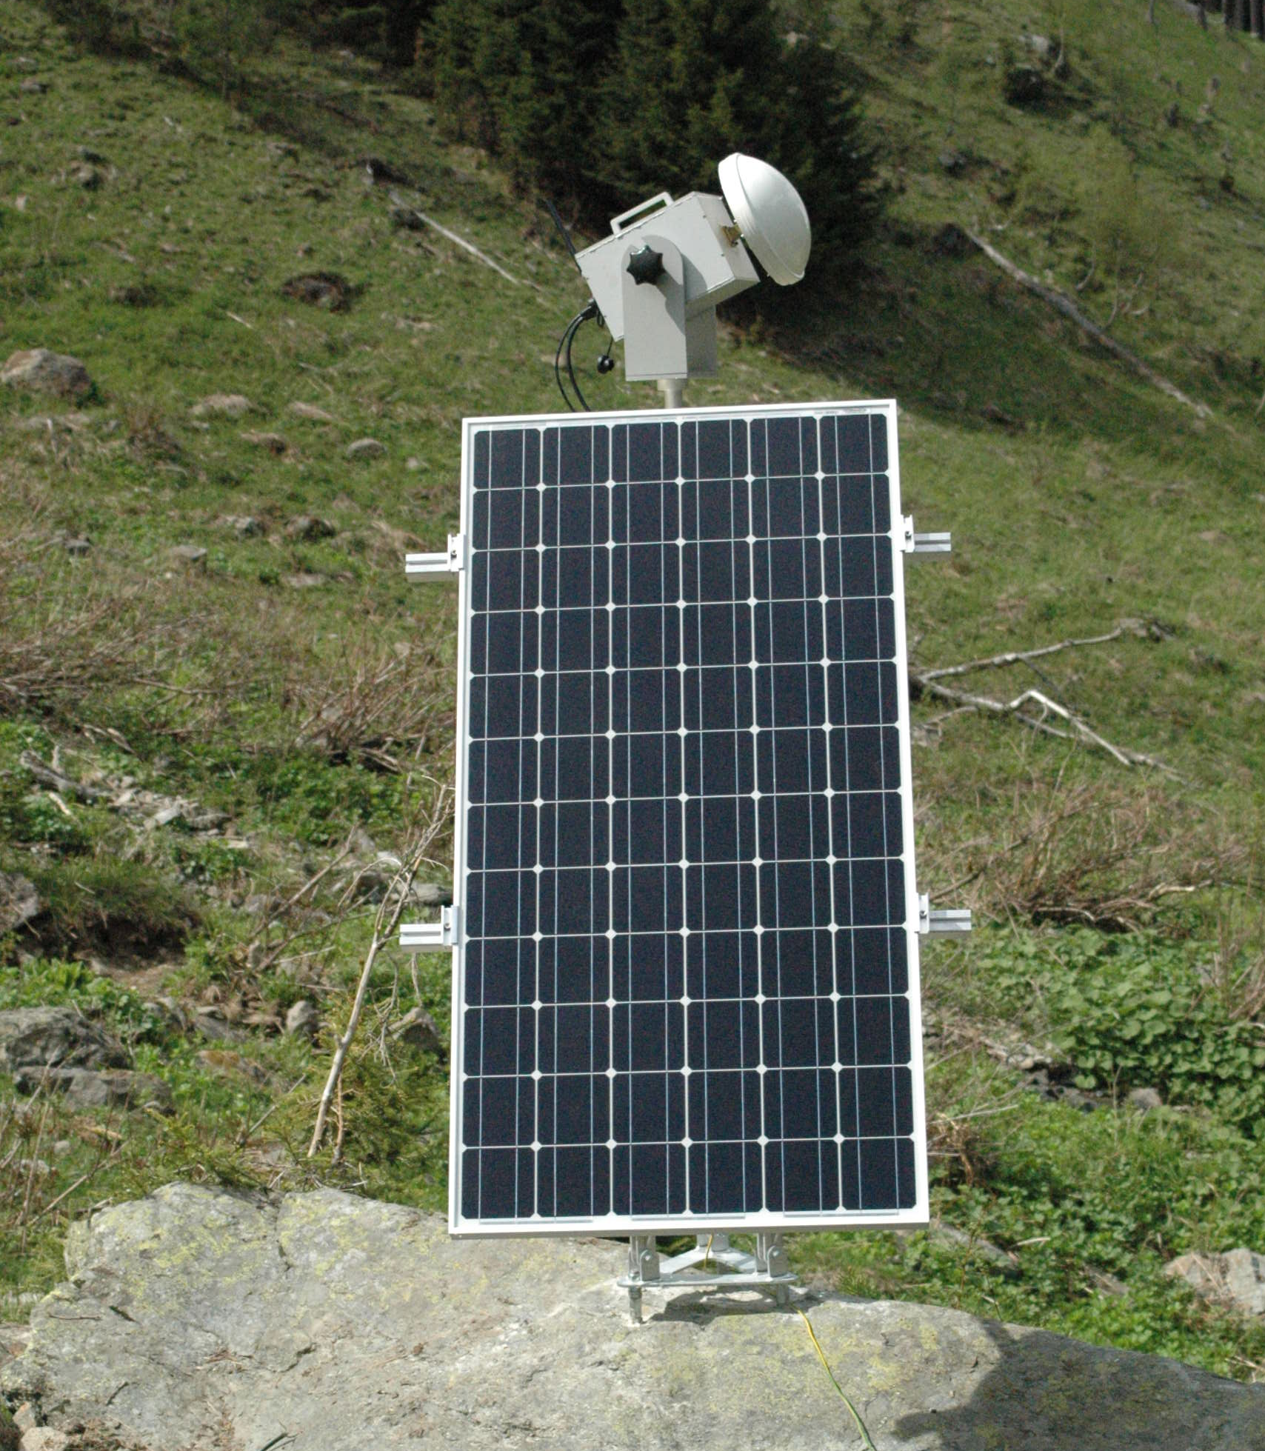
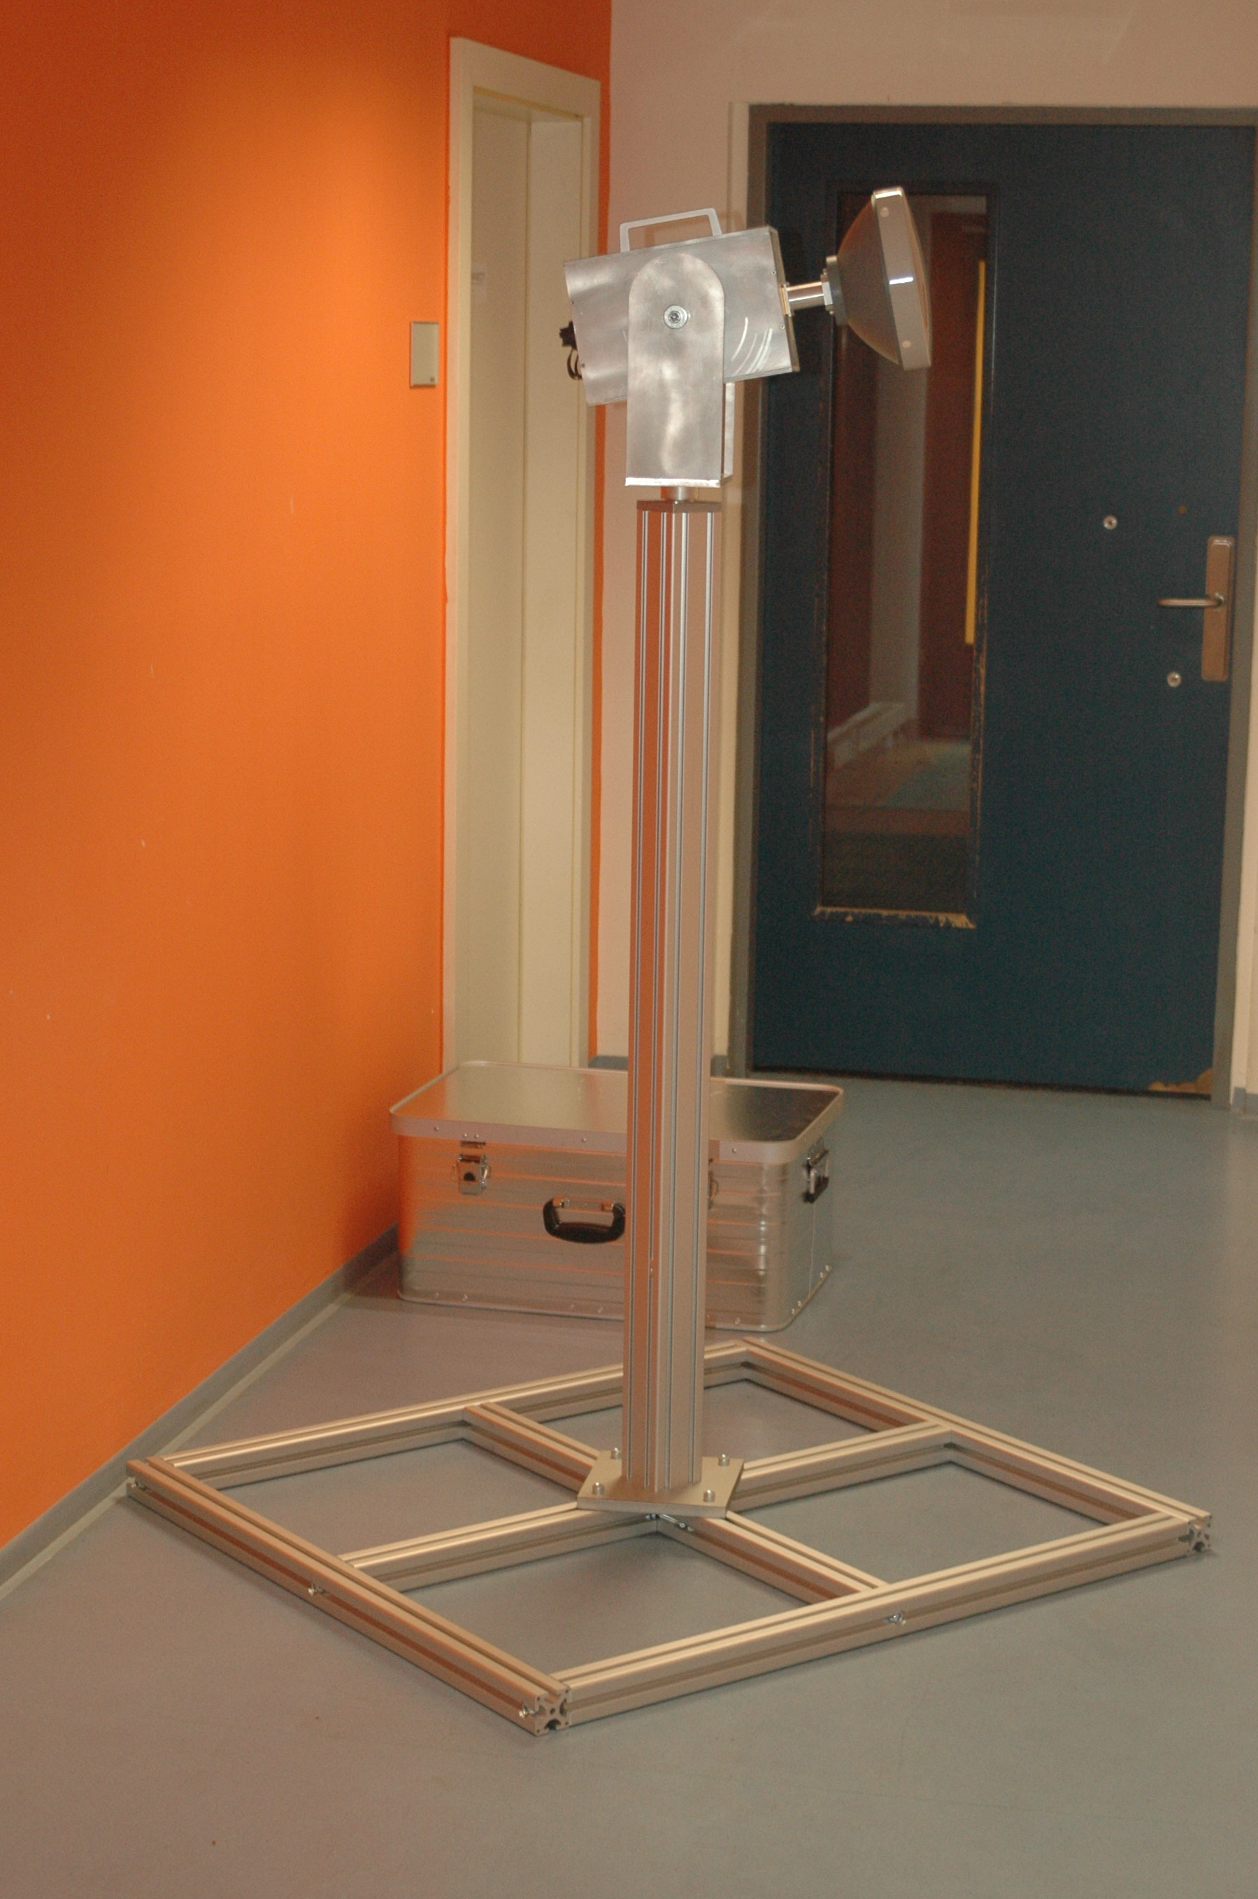
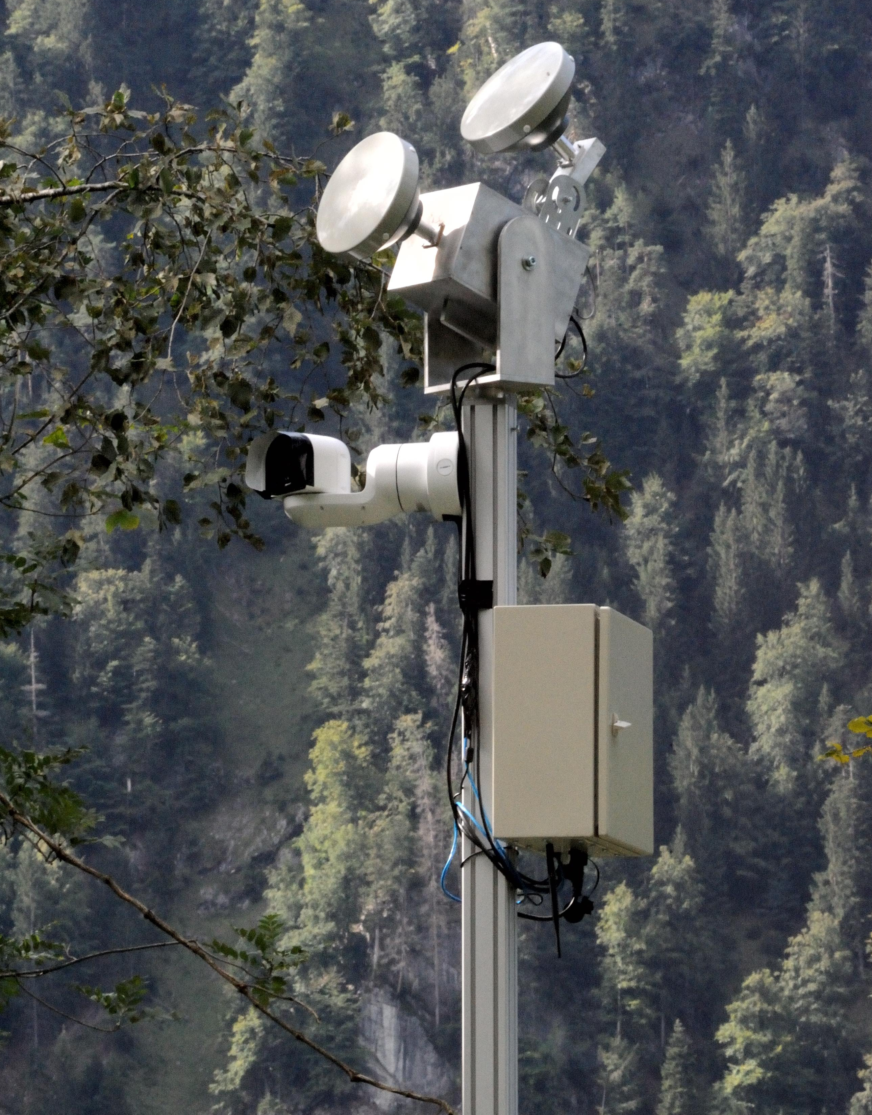
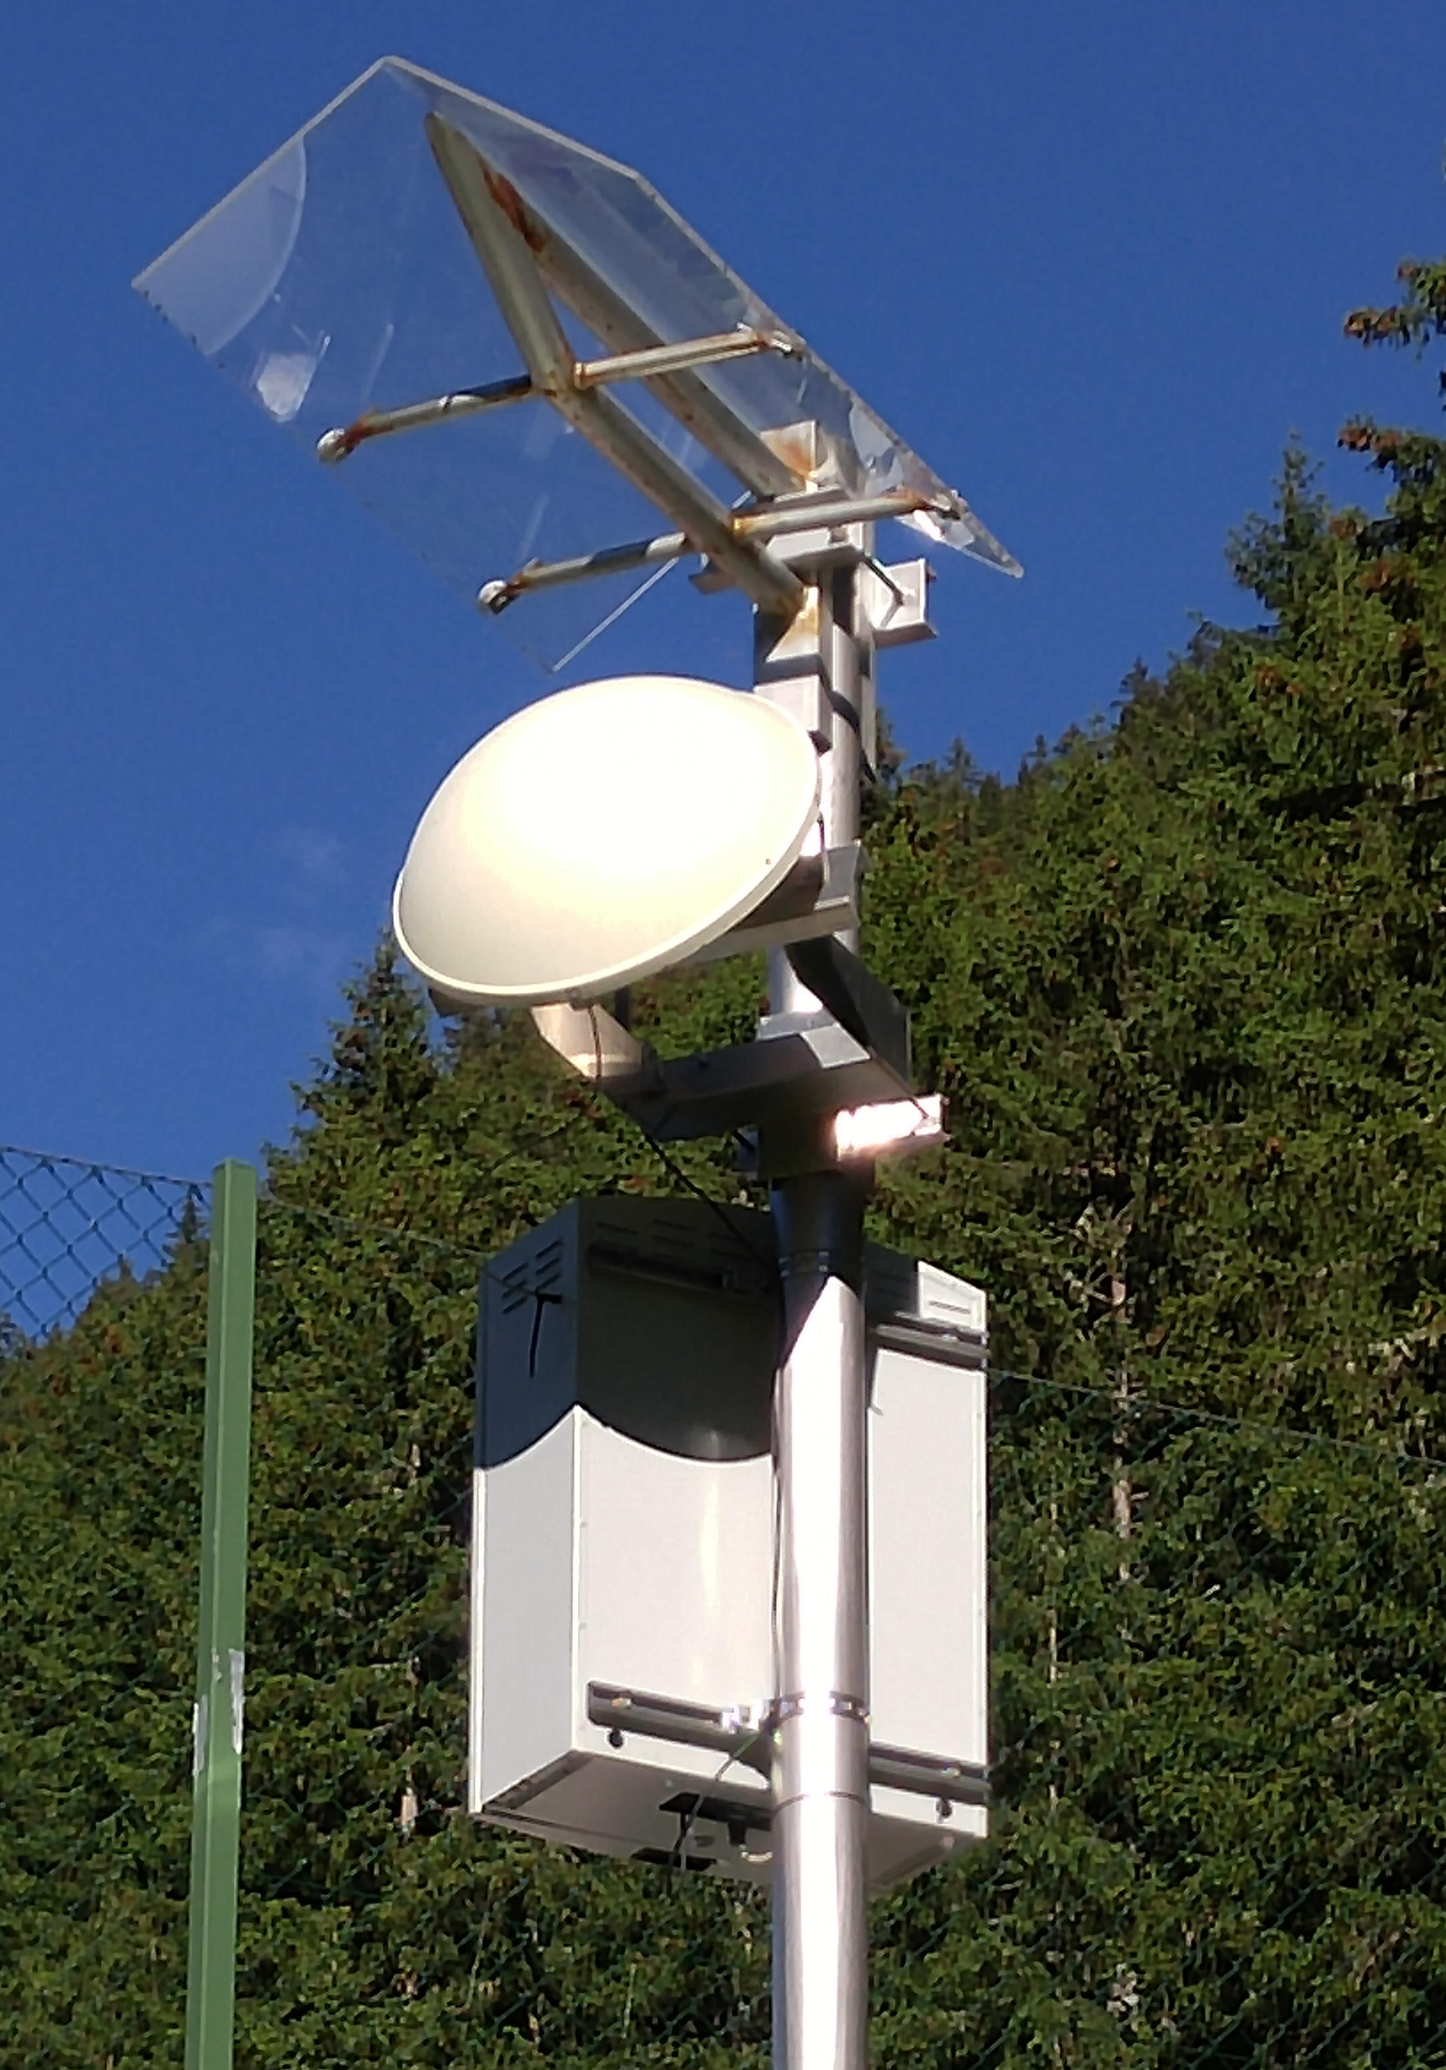
SOME EXAMBLE INSTALATION S OF THE PULSE RADAR

Slide 7
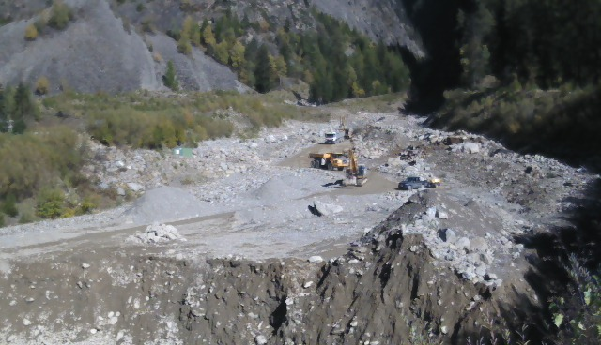
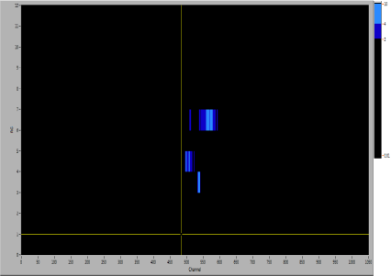
SOME EXAMPLE DATA

Slide 8
BENEFITS AND ADVANTAGES OF THE ROCKFALL SENSORS
In our test facilities (currently 6 around the world) it has been demonstrated that the size and position of an impact object, as well as the detection of any ground motion or vibration, can be determined with high accuracy.
The sensors report at the interval required by the customer and the data from each sensor converge in a database that can be viewed via a web interface.
Alarm parameters can be set on the web interface
Bring your fence to the internet of things

Slide 9
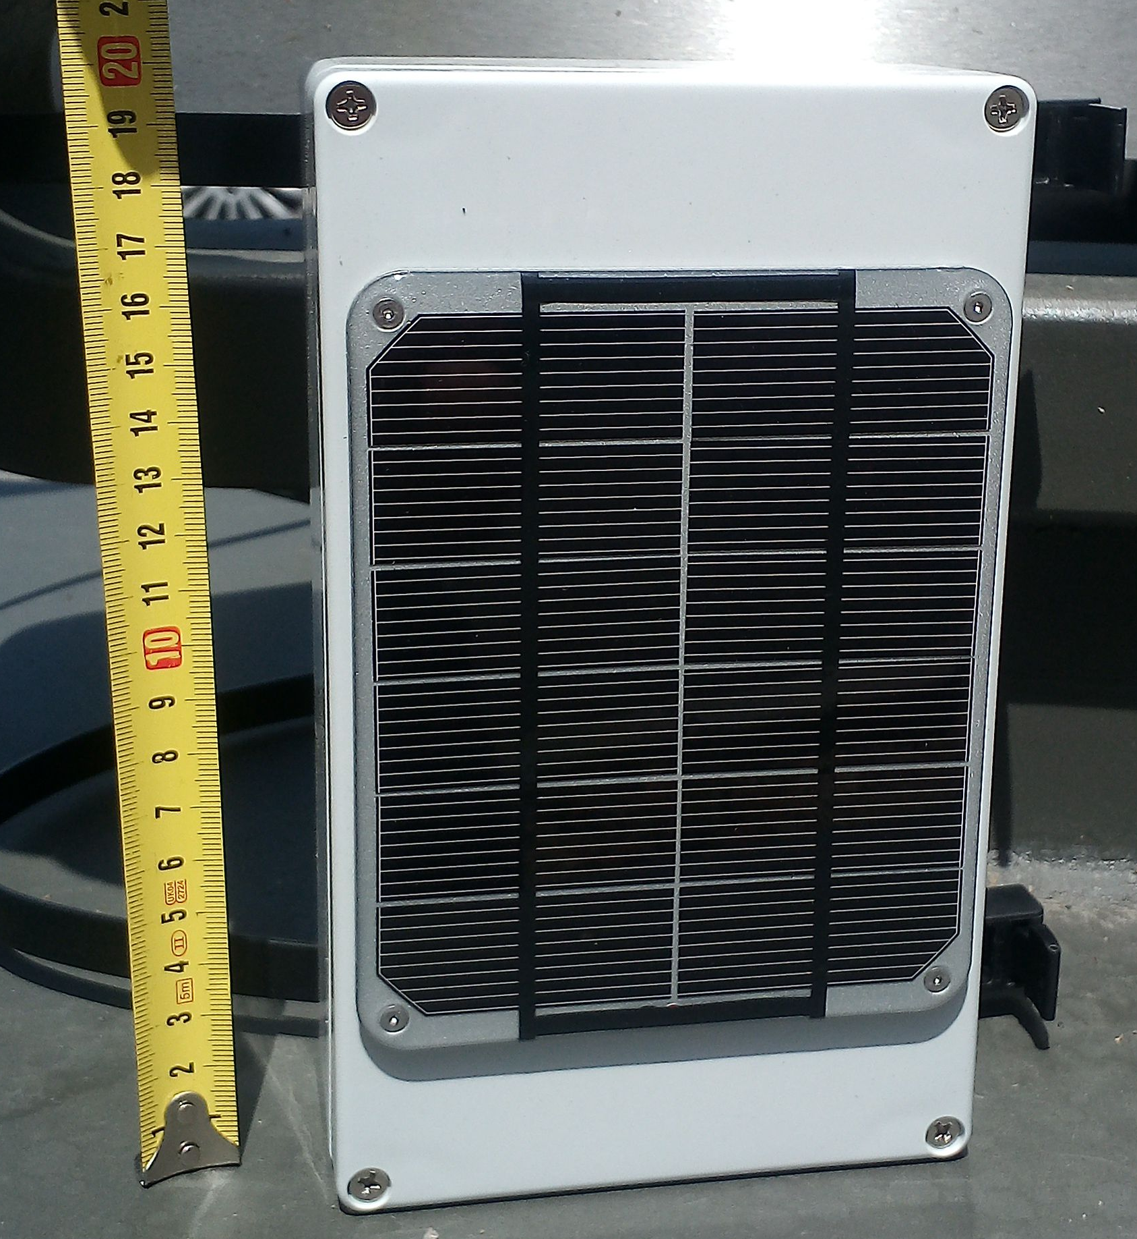
BENEFITS AND ADVANTAGES OF THE ROCKFALL SENSORS
Digital Accelerometer Sensor | Name | ADXL343
 | Low power consumption | 23 µA
 | operating temperature range | -40C to +85C
 | End-user resolution | 8 bit
 | supply voltage range: | 2.0 V to 3.6 V
 | g-Range: | +/- 16 g

Slide 10
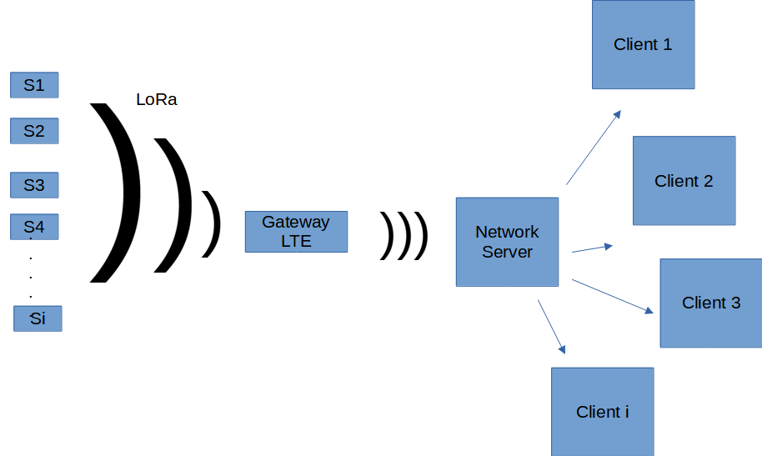
BENEFITS AND ADVANTAGES OF THE ROCKFALL SENSORS

Slide 11
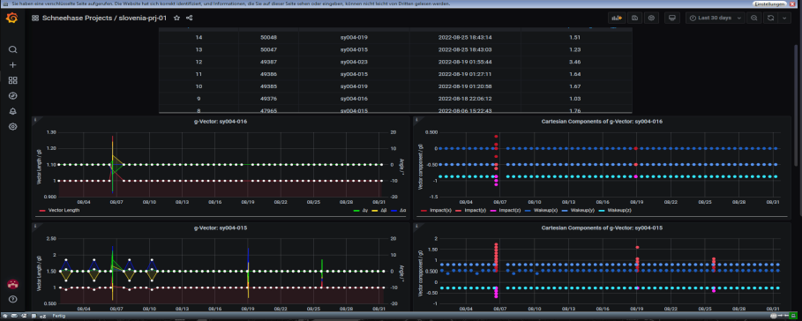
BENEFITS AND ADVANTAGES OF THE ROCKFALL SENSORS

Slide 12
VALUABLE PROPOSALS
OPERATIVITY
SECURITY
COST SAVING
It allows the continuity of mining operations by monitoring the land in areas of potential risk and anticipating the occurrence of hazards, including the alarming of brakedown of dams and phenomena such as rock bursts or earth or rock movements caused by human activities or natural phenomena
The system controls the flow of people, objects, machinery and animals within the mine site, avoiding agglomerations in the sectors defined by the client, thus preventing possible accidents. At the same time, the technology acts as a virtual perimeter, alerting the entry and exit of people or vehicles through unauthorised areas, preventing, among other things, the possibility of theft of machinery or vehicles.
The technology developed by IBTP Koschuch, a pioneer in the world, provides an integral solution for phenomena such as earth and rock displacements, access control throughout the worksite area and monitoring of people and objects, avoiding the need to hire different suppliers to deal with these contingencies separately, a situation that translates into a reduction in costs.
In turn, the radar data can be stored and analysed to converge all the technologies operating within the mine site.

Slide 13
POSSIBLE USES OF THE IBTP KOSCHUCH SERVICES
The technology controls huge areas of land, including underground operations.
Ground sensors monitor the entire area defined by the customer and warn of potential hazards related to earth and rock displacements, avalanches, structural collapse of tailings dams, etc.
The radar allows any secondary warning system to be activated and identifies any intruder or intruder vehicle in the area.
Through a chip installed in the personnel identification card, the radar makes it possible to locate each worker.
The data collected facilitates an analysis of the functioning and operation of the activities within the mine site

Slide 14
OPERABILITY, FUNCTIONING AND MAINTENANCE OF EQUIPMENT
Certification and Patenting of equipment (European certification).
Transport and ease of installation of the equipment.
Possibility to monitor the radar activities in Austria (IBTP Koschuch headquarters)
Training of personnel on the spot for the handling, control, storage and analysis of radar data.
Operational guarantee.
Support and maintenance of the equipment over time (by checking its functioning, repairing structures in case of damage, and adapting the agorithms to suit new needs).

Slide 15
POTENTIAL APPLICATIONS FOR MINING ACTIVITY
Early control and immediate warning in case of slopes and landslides that may jeopardise the development of the activity within the mine and the safety of personnel.
Immediate control and alert in case of rock and soil displacements caused by human activities or climatic phenomena that may pose a direct danger to people in the area.
Prompt monitoring and immediate alarming of walls in underground tunnels.
Timely monitoring and early alert in case of danger on the stability and functioning of dam dyke.
Control of personnel entering specified virtual perimeters.
Control of the entry and exit of vehicles and machinery within the virtual perimeter.
Prevention of theft within the site, through monitoring and identification of people and objects.
Avoidance of possible occupational accidents by monitoring the movement of people and objects within the defined perimeter.
Storage and studies of the data produced by the radar in the different activities for which it will be used.

