Slide 1
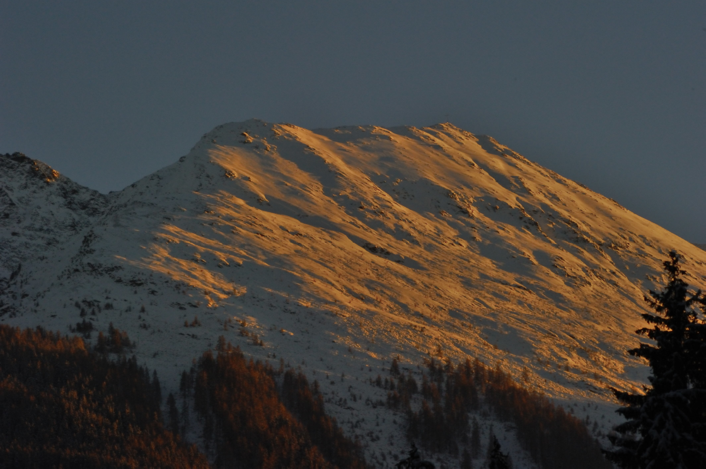
8 years experience in avalanche detection
by using a Pulse Doppler Radar
DI Dr. techn. Koschuch Richard
IBTP Koschuch e.U.
Langegg 31
A-8463 Glanz an der Weinstraße
+ 43 / 699 18448542
office@ibtp-koschuch.com
www.ibtp-koschuch.com
www.avalancheradar.com
<Foliennummer>/31

Slide 2
Principle of the Pulse Radar
The RADAR emits modulated pulses
Notes:
Spezialisten aus den Bereichen Radartechnik, Elektronik, Weltraumforschung, Softwareentwicklung und Logistik

Slide 3
Principle of the Pulse Radar
The RADAR emits modulated pulses
Max. measurement distance R = 5 km
Notes:
Spezialisten aus den Bereichen Radartechnik, Elektronik, Weltraumforschung, Softwareentwicklung und Logistik

Slide 4
Principle of the Pulse Radar
The RADAR emits modulated pulses
Max. measurement distance R = 5 km
RG-length r_{RG}=15-250 m
Notes:
Spezialisten aus den Bereichen Radartechnik, Elektronik, Weltraumforschung, Softwareentwicklung und Logistik

Slide 5
Principle of the Pulse Radar
v₃
The RADAR emits modulated pulses
Max. measurement distance R = 5 km
RG-length r_{RG}=15-250 m
Velocities up to 300 km/h are detected simultaneously in each RG
v₂
v₁
Notes:
Spezialisten aus den Bereichen Radartechnik, Elektronik, Weltraumforschung, Softwareentwicklung und Logistik

Slide 6
Principle of the Radar
The RADAR emits modulated pulses
Max. measurement distance R = 5 km
RG-length r_{RG}=15-250 m
Velocities up to 300 km/h are detected simultaneously in each RG
If there is a hazardous event (fast moving objects), data run trough an algorithm and in case an alarming trigger is activated.
Notes:
Spezialisten aus den Bereichen Radartechnik, Elektronik, Weltraumforschung, Softwareentwicklung und Logistik

Slide 7

Principle of the Pulse Radar
Snow Avalanches
Debris Flow
Water Level Detection
Rockfall
Man Detection
Rain Detection
Notes:
Spezialisten aus den Bereichen Radartechnik, Elektronik, Weltraumforschung, Softwareentwicklung und Logistik

Slide 8
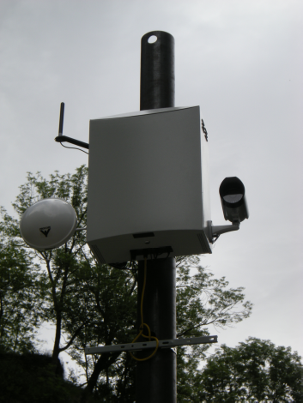
Specification
Parameter | Quantity | Tolerance | Unit
Mode | Pulse/PCM
Frequency | 10.0-10.5 |  | GHz
Power C. | 40 | < | W
Range | 30-5000 |  | m
Targetsize | 1 | min > at 2km | m²
 | 0,25 | min > at 1km | m²
Velocity | 0,2-100 | min/max | m/s
RG | 128 | max
RG-length | 15-250 | min/max | m
Notes:
Spezialisten aus den Bereichen Radartechnik, Elektronik, Weltraumforschung, Softwareentwicklung und Logistik

Slide 9
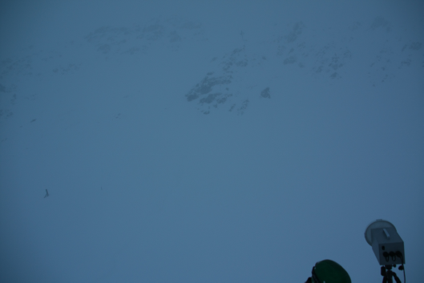
Function I: Mobile RADAR
Mobile Radar in Action; Fotos Daniel Lussi, SLF

Slide 10
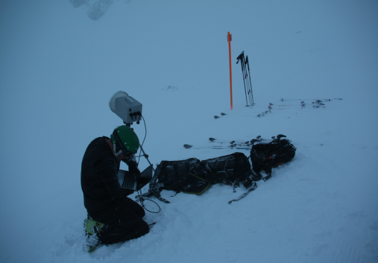
Function I: Mobile RADAR
Mobile Radar in Action; Fotos Daniel Lussi, SLF

Slide 11
Function I: Mobile RADAR
Mobile Radar in Action; Fotos Daniel Lussi, SLF

Slide 12
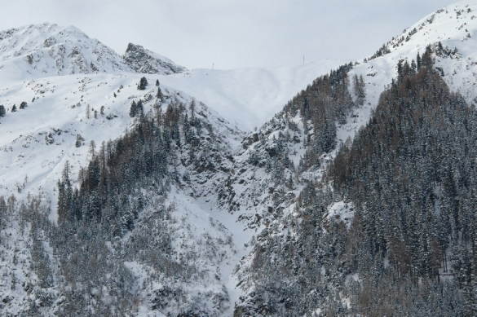
Function II: Fix Installation Ischgl

Slide 13
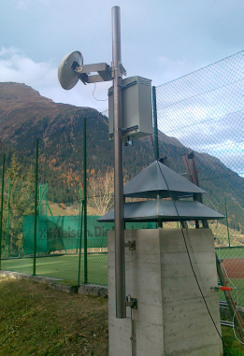
Function II: Fix Installation Ischgl

Slide 14
Function II: Fix Installation Ischgl

Slide 15
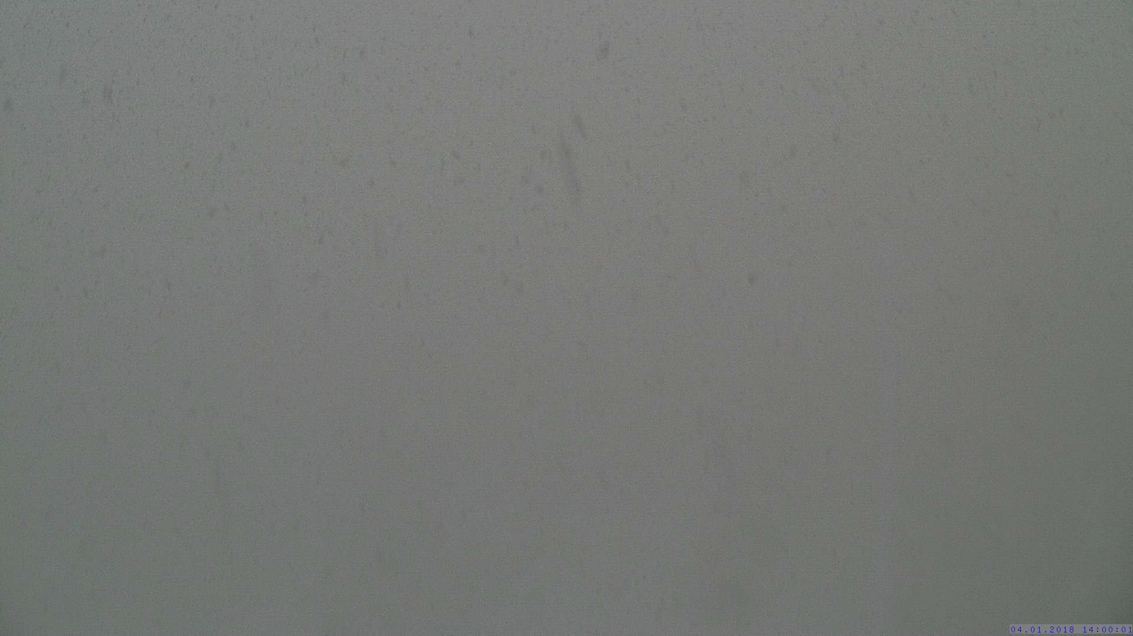
Function II: Fix Installation Ischgl

Slide 16
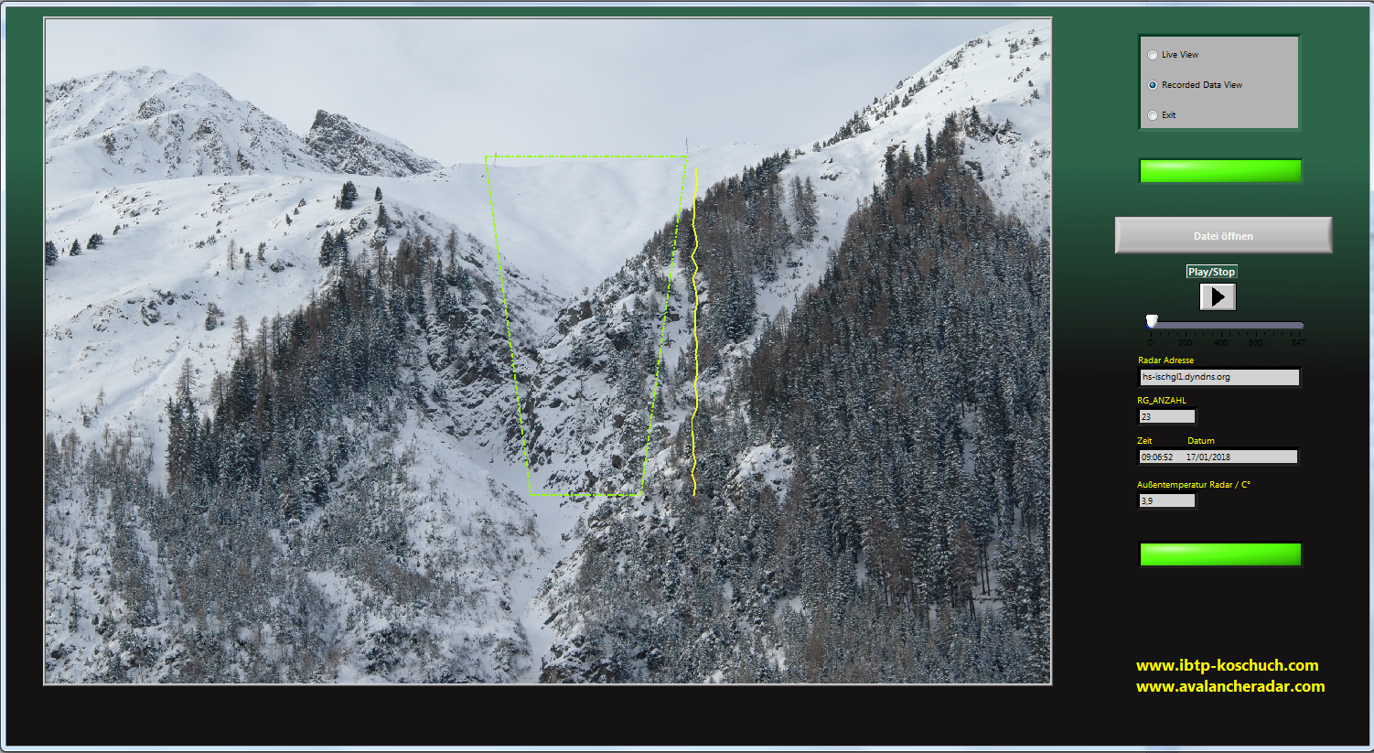
Function II: Fix Installation Ischgl

Slide 17
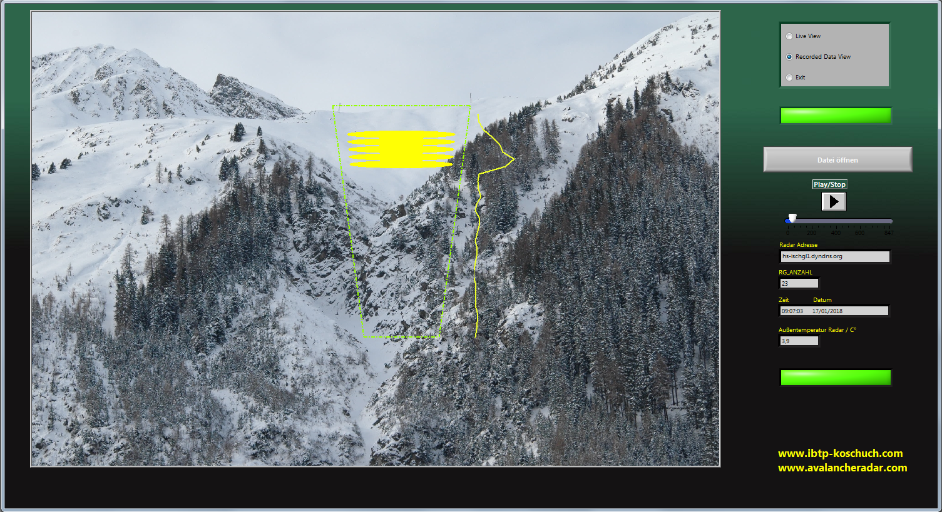
Function II: Fix Installation Ischgl

Slide 18
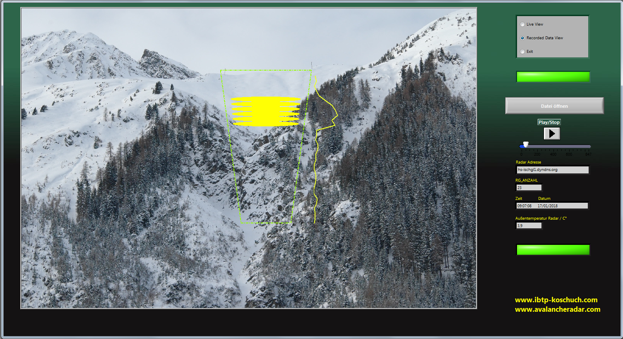
Function II: Fix Installation Ischgl

Slide 19
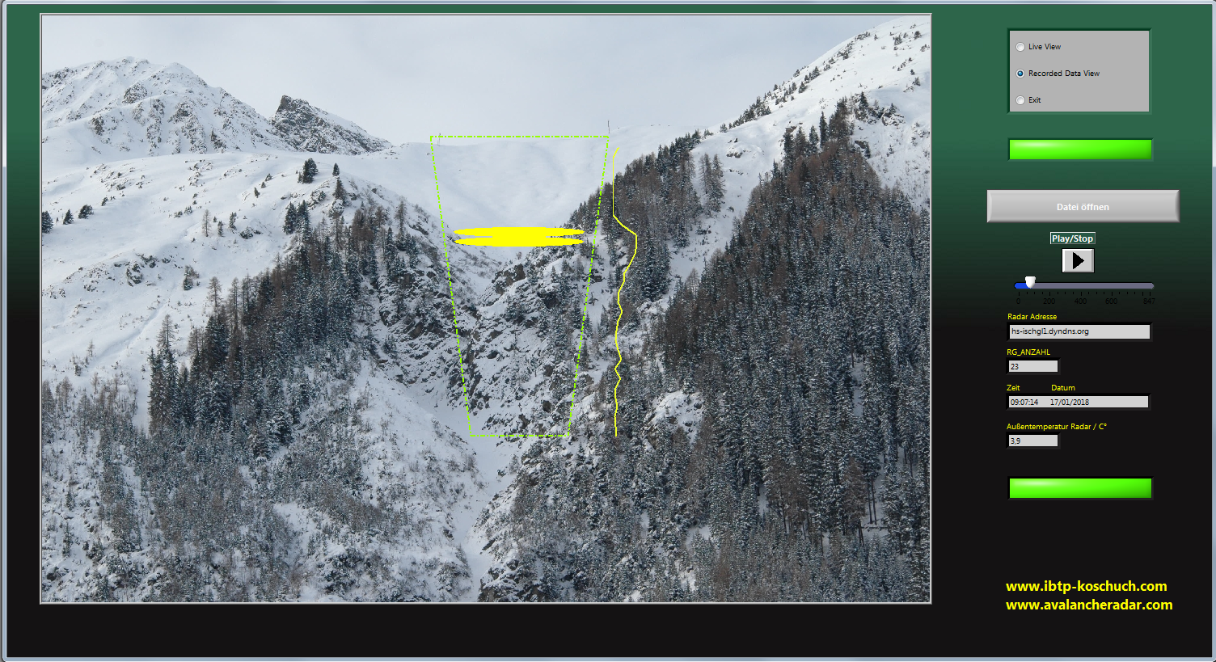
Function II: Fix Installation Ischgl

Slide 20
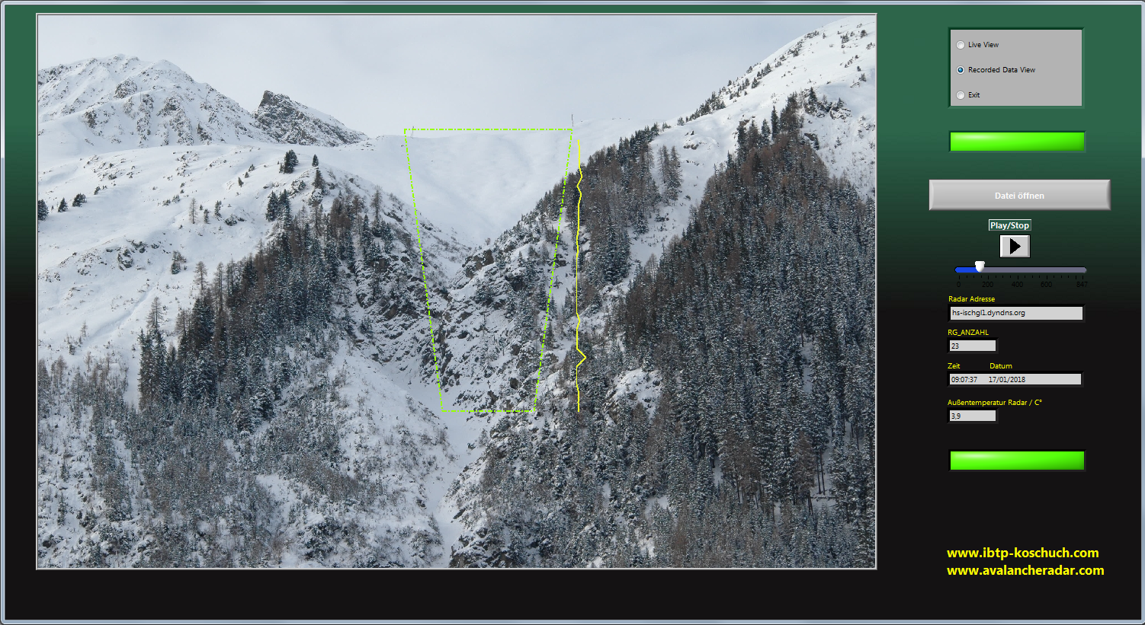
Function II: Fix Installation Ischgl

Slide 21
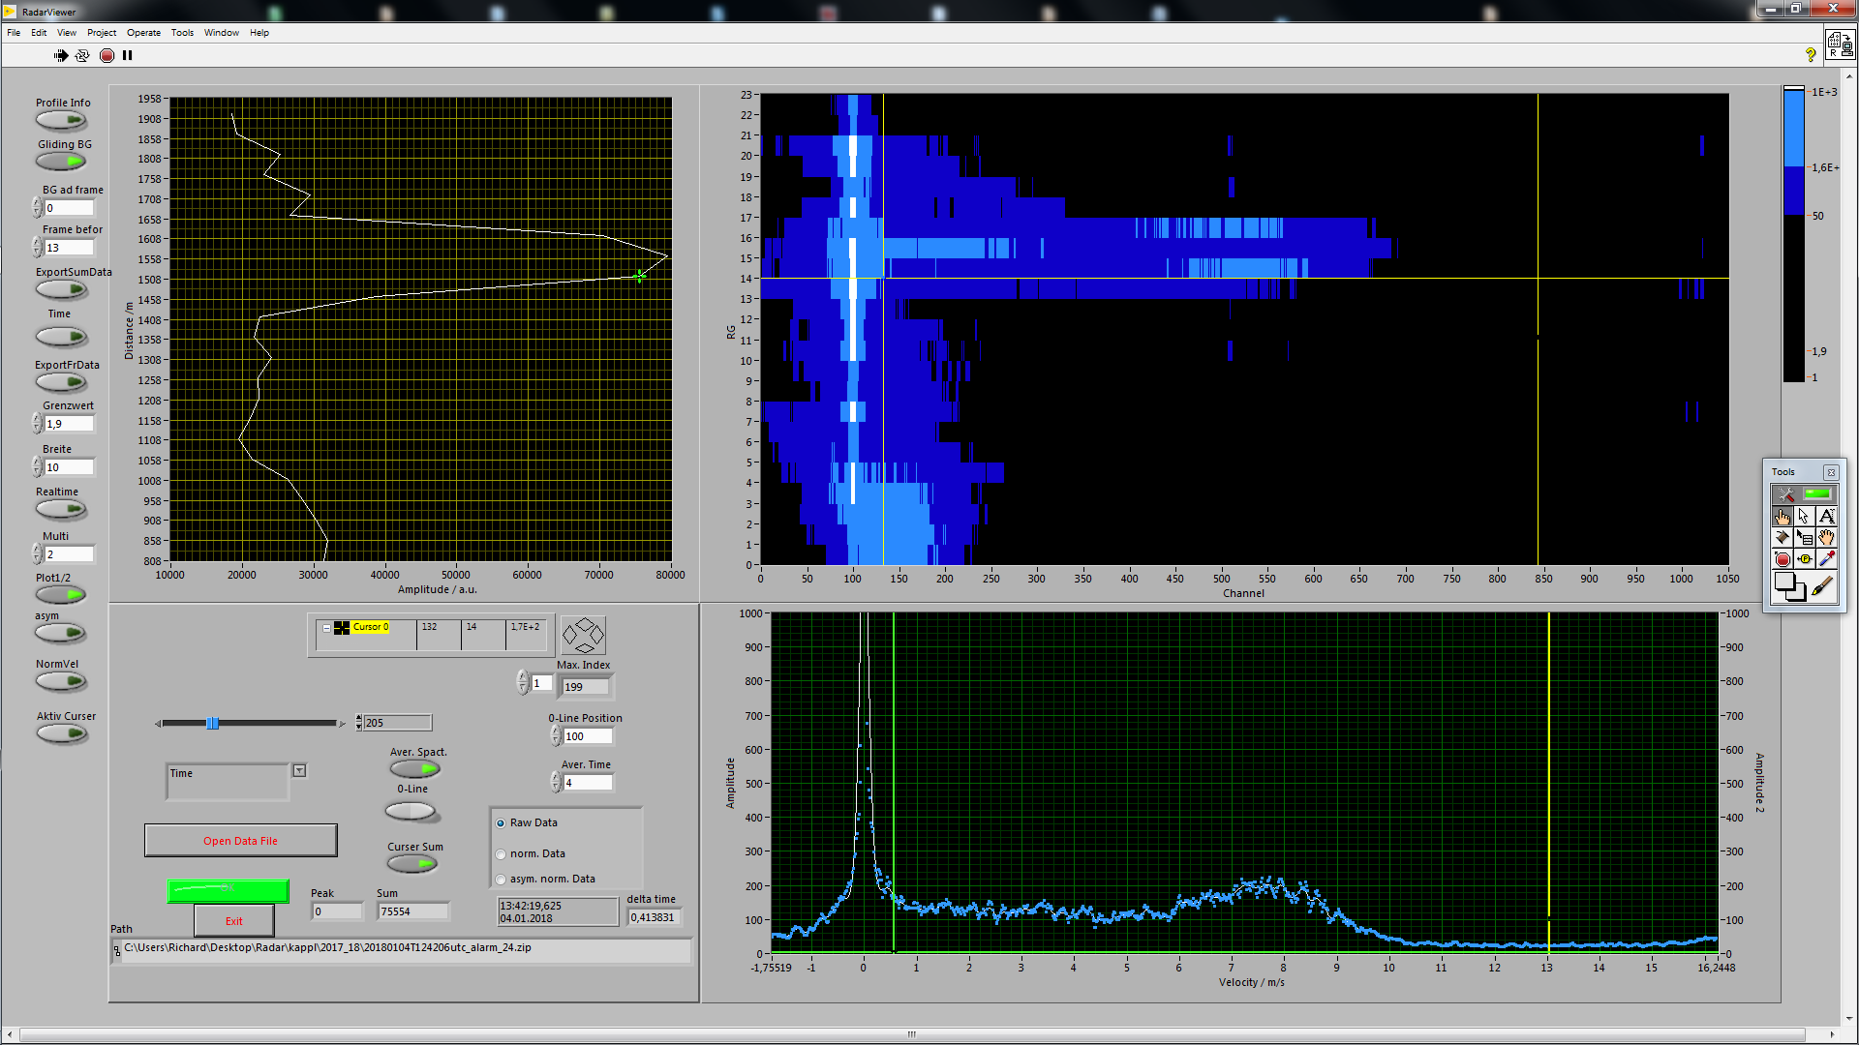
Function II: Avalanche during heavy Rainfall
Velocity Spectrum
Avalanche RG14

Slide 22

Function II: Avalanche during heavy Rainfall
Velocity Spectrum
Rain RG1

Slide 23
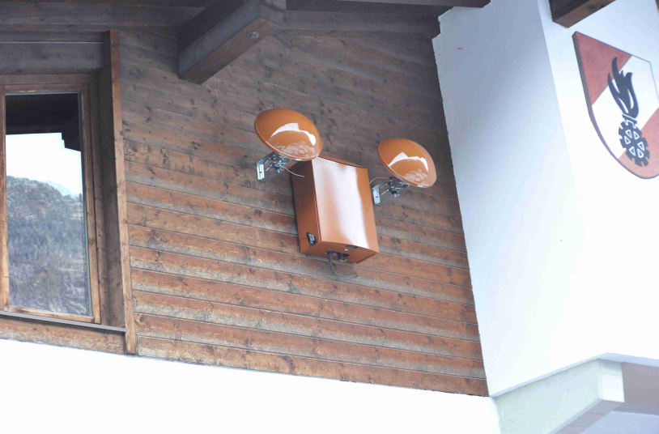
Function II: Installation Pitztal

Slide 24
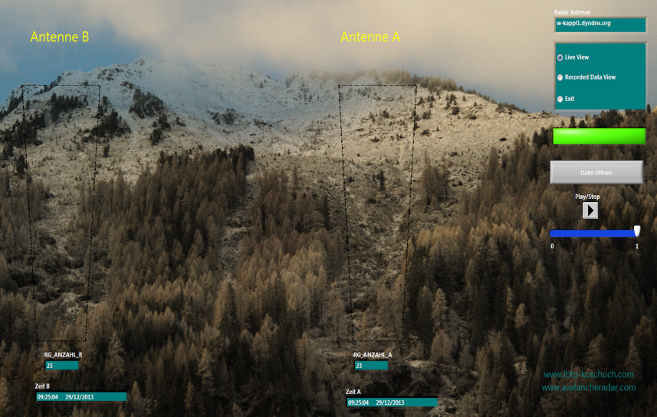
Function II: Installation Pitztal

Slide 25
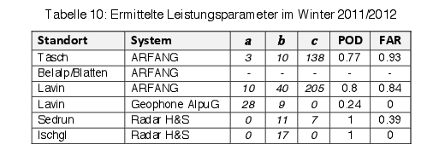
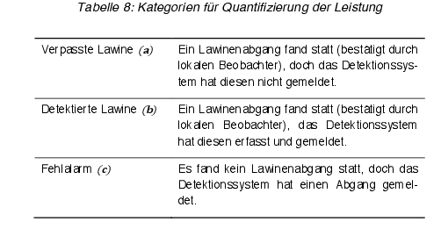
Project Avalanche Detection Systems SLF
Summery Comparison Tests SLF:

Slide 26
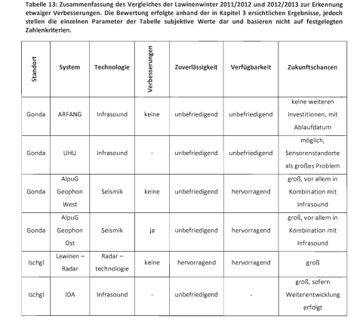
Master Thesis Boku Vienna
Summery Thesis Christian Kienberger 2013:
„Evaluation of Avalanche Detection Systems and Development of a Plan for a Simple Detection System“
Avalancheradar

Slide 27
Avalanche Detection Radar
Avalanche Detection Rate for installed Radar Systems:
Place of Radar | Years of operation | Alarm and Avalanche | False Alarm | No Alarm but Avalanche
Sedrun | 2010-2012 | 12 | 7* | 0
Ischgl | 2011- | 102 | 3** | 0
Kaunertal | 2012- | 8 | 1*** | 0
Kappl | 2012- | 287 | 7** | 2****
* all alarms within one hour caused by a truck covering time by time the detection- cone
** all alarms on one evening within 2 hours caused by a heavy rain shower in January; new algorithm can handle this.
*** Module defect
**** Radar detected the avalanche, but the phone connection was broken

Slide 28
Technology and Benefits of the System I
Reliable recognition of avalanches, mudslides, debris flow and water level changes
  Minimization of false alerts
Low transmitted power
  Energy and environment friendly
Possibility of mobile operations
Low installation requirements
  Only a mast and a power supply of 40 W
Notes:
Geringe Sendeleistung: 100mW

Slide 29
Technology and Benefits of the System II
Recognition of risk in real time (within a second)
  maximum warning
Multifunctional alert system
  trigger to local signal systems
  real time information to central warning institutions via SMS, Email, LiveViewer…
  fast, save and regardless from weather conditions
Notes:
Erkennungszeitraum: 1 – 2 Sekunden
Multifunktionales Warnsystem
Lokale Signaleinrichtungen (z. B. Ampelanlagen zum Sperren einer Straße, Signalhörner)
Relaisausgänge
Mobilfunktechnik (SMS, Email)
Landeswarnzentrale, Straßendienst, Bergrettung, etc.
Bilderfassungseinheit (Ermittlung des Verursachers, Detektion von Verschütteten, etc.)

Slide 30
Conclusion
We are able to detect reliable even smallest avalanches in any weather conditions
The Radar-availability is very high and is continuously checked online
The falsalarm quote is extremely low
We can provide an optimal setup for each location
Notes:
Spezialisten aus den Bereichen Radartechnik, Elektronik, Weltraumforschung, Softwareentwicklung und Logistik

Slide 31
Thank You
Thank You
Notes:
Spezialisten aus den Bereichen Radartechnik, Elektronik, Weltraumforschung, Softwareentwicklung und Logistik

