Slide 1
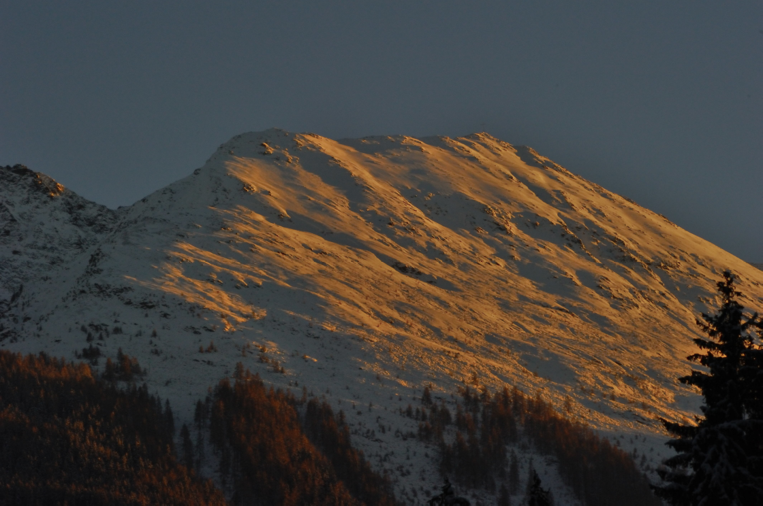
Avalanche-, Debris Flow- and Mudslide RADAR
DI Dr. techn. Koschuch Richard
IBTP Koschuch e.U.
Langegg 31
A-8463 Glanz an der Weinstraße
+ 43 / 699 18448542
office@ibtp-koschuch.com
www.ibtp-koschuch.com
www.avalancheradar.com
<Foliennummer>/25

Slide 2
Principle of the Radar
The RADAR emits modulated pulses
Max. measurement distance R=2,5 km
RG-length r_{RG}=15-250 m
Notes:
Spezialisten aus den Bereichen Radartechnik, Elektronik, Weltraumforschung, Softwareentwicklung und Logistik

Slide 3
Principle of the Radar
The RADAR emits modulated pulses
Max. measurement distance R=2,5 km
RG-length r_{RG}=15-250 m
Velocities up to 300 km/h are detected simultaneously in each RG
If there is a hazardous event (fast moving objects), a alarming trigger is activated.
Notes:
Spezialisten aus den Bereichen Radartechnik, Elektronik, Weltraumforschung, Softwareentwicklung und Logistik

Slide 4

Areas of application for the Radar
Snow Avalanches
Debris Flow
Water Level Detection
Rain Detection
Rockfall
Man Detection
Notes:
Spezialisten aus den Bereichen Radartechnik, Elektronik, Weltraumforschung, Softwareentwicklung und Logistik

Slide 5
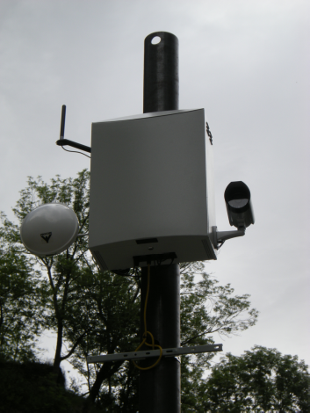
Specification
Parameter | Quantity | Tolerance | Unit
Mode | Pulse/PCM
Frequency | 10,0-10,5 |  | GHz
Power C. | 40 | < | W
Range | 30-2500 |  | m
Targetsize | 1 | min > at 2km | m²
 | 0,25 | min > at 1km | m²
Velocity | 0,2-100 | min/max | m/s
RG | 128 | max
RG-length | 15-250 | min/max | m
Notes:
Spezialisten aus den Bereichen Radartechnik, Elektronik, Weltraumforschung, Softwareentwicklung und Logistik

Slide 6
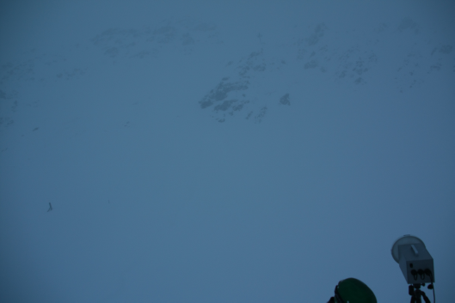
Function I: Mobile RADAR
Mobile Radar in Action; Fotos Daniel Lussi, SLF

Slide 7
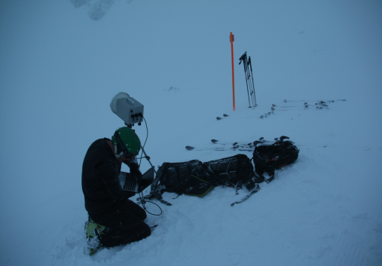
Function I: Mobile RADAR
Mobile Radar in Action; Fotos Daniel Lussi, SLF

Slide 8
Function I: Mobile RADAR
Mobile Radar in Action; Fotos Daniel Lussi, SLF

Slide 9
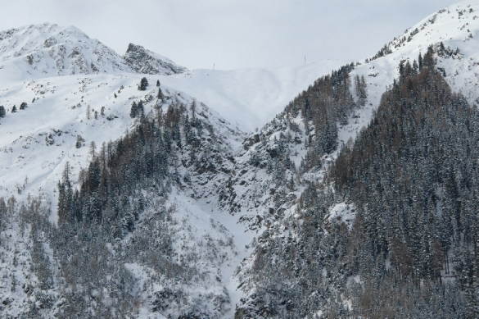
Function II: Fix Installation Ischgl

Slide 10
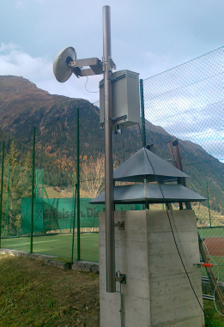
Function II: Fix Installation Ischgl

Slide 11
Function II: Fix Installation Ischgl

Slide 12
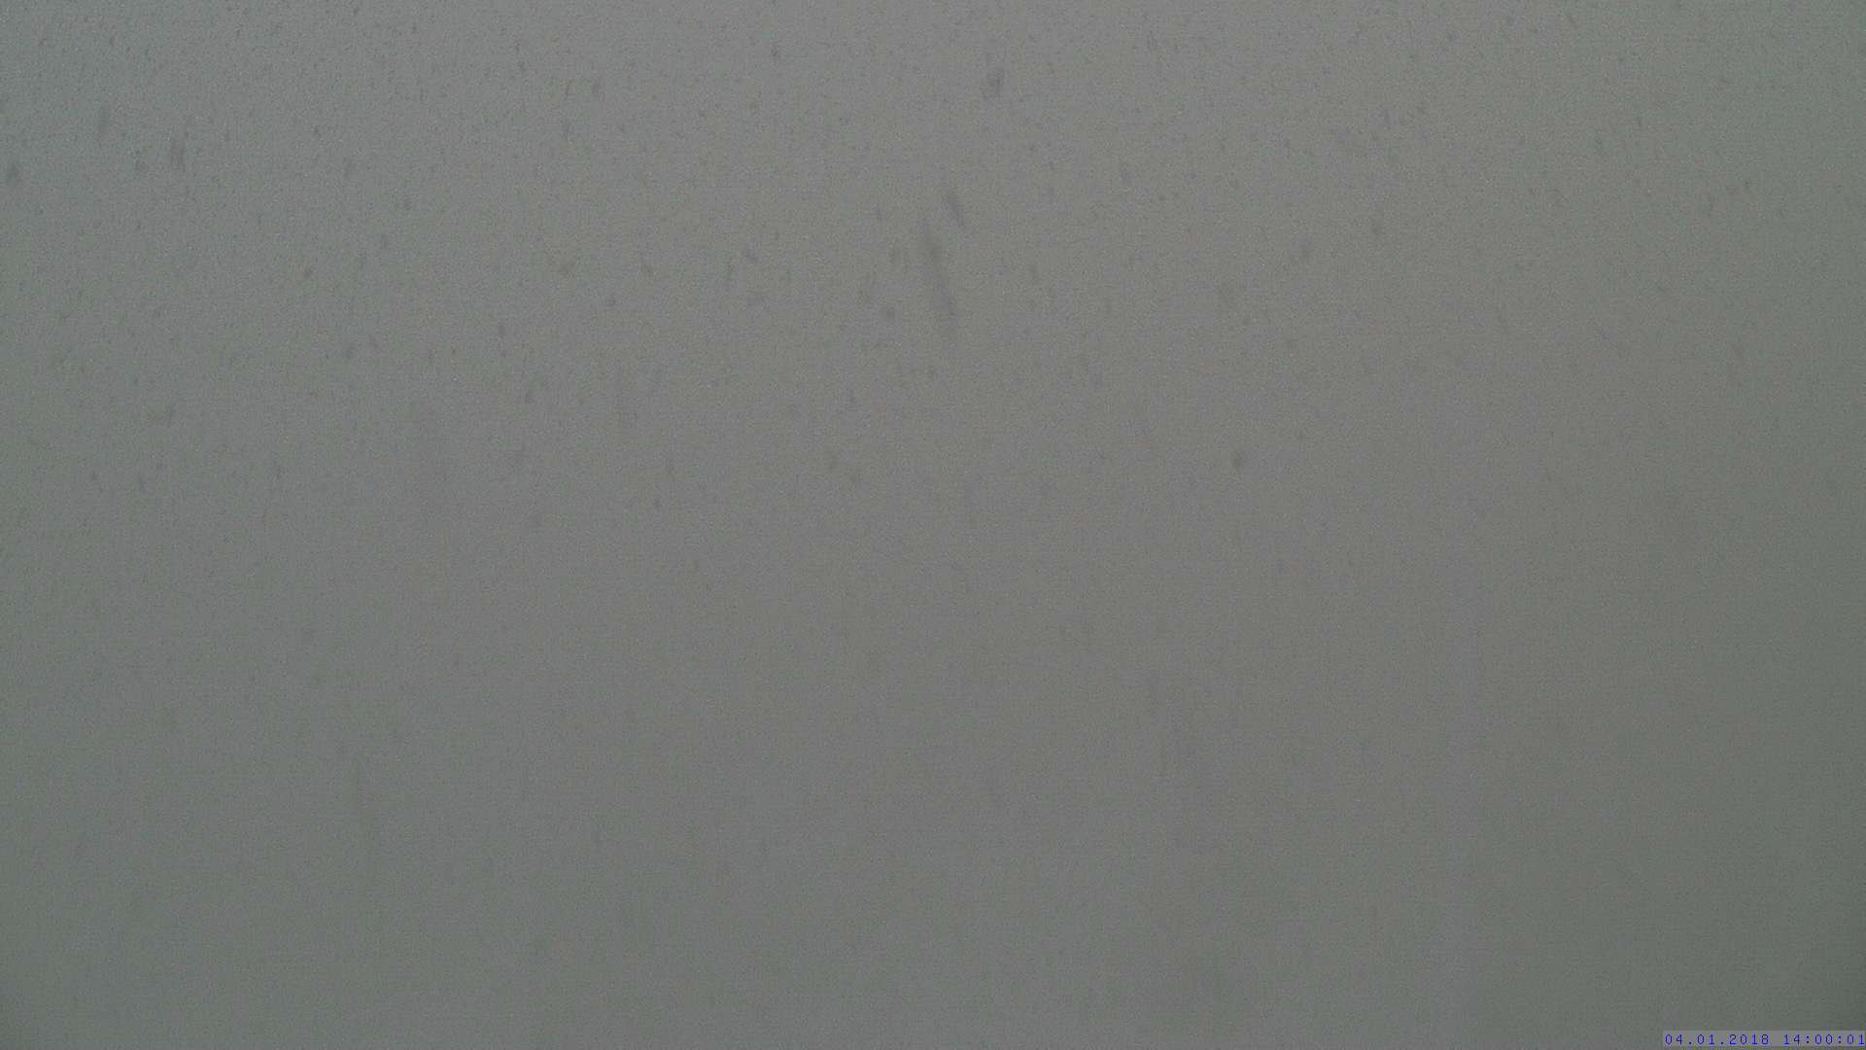
Function II: Fix Installation Ischgl

Slide 13
Function II: Fix Installation Ischgl

Slide 14
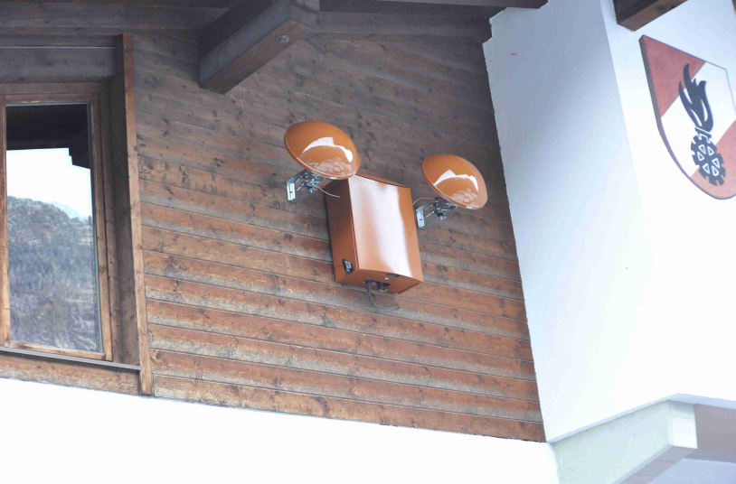
Function II: Installation Pitztal

Slide 15
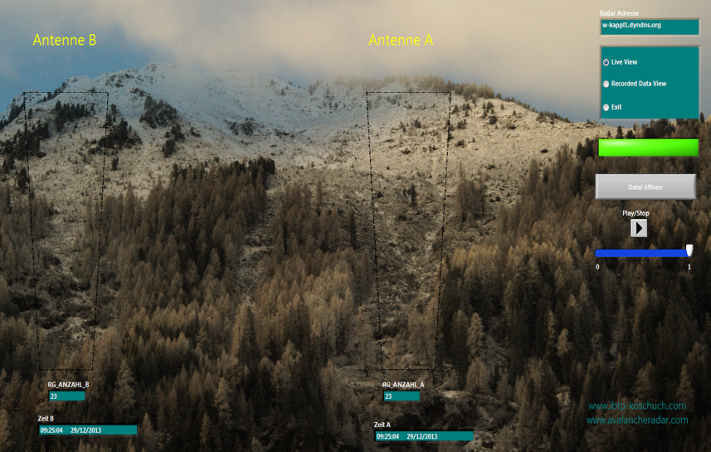
Function II: Installation Pitztal

Slide 16
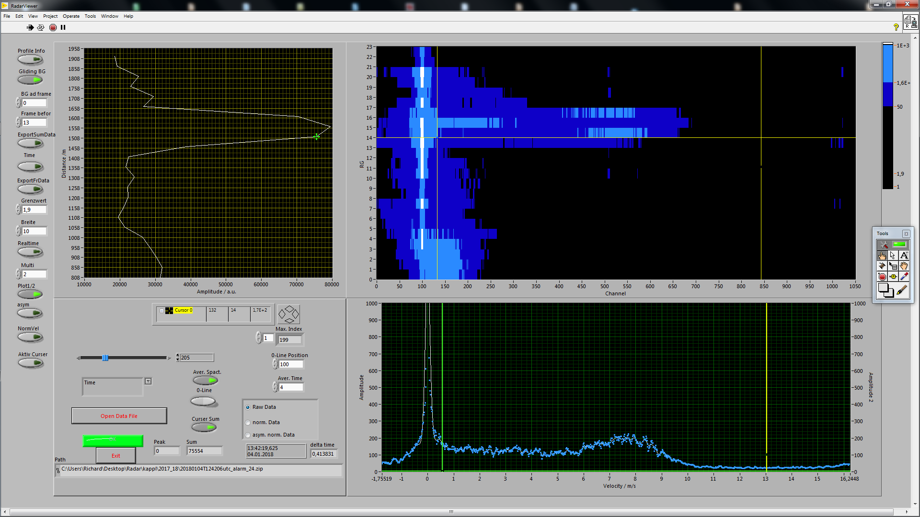
Function II: Avalanche during heavy Rainfall

Slide 17

Function II: Avalanche during heavy Rainfall

Slide 18
Function II: Avalanche Sölden

Slide 19
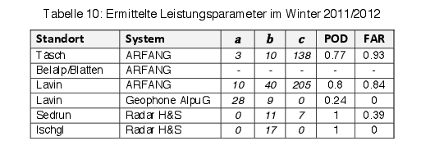
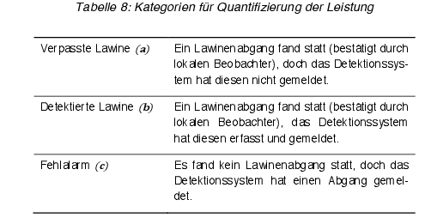
Project Avalanche Detection Systems SLF
Summery Comparison Tests SLF:

Slide 20
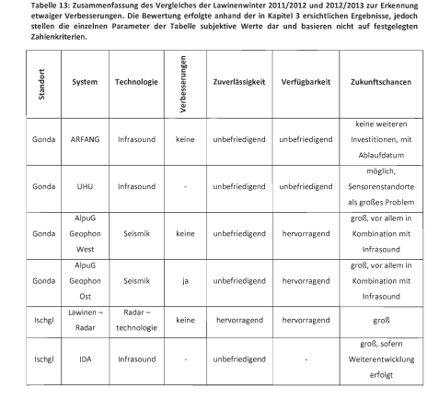
Master Thesis Boku Vienna
Summery Thesis Christian Kienberger 2013:
„Evaluation of Avalanche Detection Systems and Development of a Plan for a Simple Detection System“
Avalancheradar

Slide 21
Avalanche Detection Radar
Avalanche Detection Rate for installed Radar Systems:
Place of Radar | Years of operation | Alarm and Avalanche | False Alarm | No Alarm but Avalanche
Sedrun | 2010-2012 | 12 | 7* | 0
Ischgl | 2011- | 102 | 3** | 0
Kaunertal | 2012- | 8 | 1*** | 0
Kappl | 2012- | 287 | 7** | 2****
* all alarms within one hour caused by a truck covering time by time the detection- cone
** all alarms on one evening within 2 hours caused by a heavy rain shower in January; new algorithms can handle this.
*** Module defect
**** Radar detected the avalanche, but the phone connection was broken

Slide 22
Technology and Benefits of the System I
Reliable recognition of avalanches, mudslides, debris flow and water level changes
  Minimization of false alerts
Low transmitted power
  Energy and environment friendly
Possibility of mobile operations
Low installation requirements
  Only a mast and a power supply of 40 W
Notes:
Geringe Sendeleistung: 100mW

Slide 23
Technology and Benefits of the System II
Recognition of risk in real time (within a second)
  maximum warning
Multifunctional alert system
  trigger to local signal systems
  real time information to central warning institutions via SMS, Email, LiveViewer…
  fast, save and regardless from weather conditions
Notes:
Erkennungszeitraum: 1 – 2 Sekunden
Multifunktionales Warnsystem
Lokale Signaleinrichtungen (z. B. Ampelanlagen zum Sperren einer Straße, Signalhörner)
Relaisausgänge
Mobilfunktechnik (SMS, Email)
Landeswarnzentrale, Straßendienst, Bergrettung, etc.
Bilderfassungseinheit (Ermittlung des Verursachers, Detektion von Verschütteten, etc.)

Slide 24
Conclusion
We are able to detect reliable even smallest debris flows and avalanches
We are able to detect very accurate water levels
We are able to trigger an alarming system within a second
We are also able to detect heavy rainfalls up in the sky
Notes:
Spezialisten aus den Bereichen Radartechnik, Elektronik, Weltraumforschung, Softwareentwicklung und Logistik

Slide 25
Thank You
Thank You
Notes:
Spezialisten aus den Bereichen Radartechnik, Elektronik, Weltraumforschung, Softwareentwicklung und Logistik

